Slide 1
HL7 FHIR PROFILING
HL7 WGM Henderson, NV
Richard Ettema
January 17, 2023

Slide 2
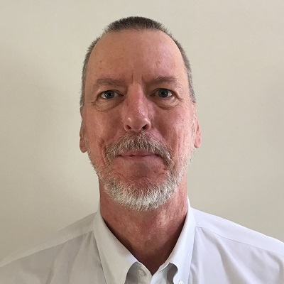
Who am I?
Name: Richard J Ettema
Company: AEGIS.net, Inc.
Background:
39+ years IT industry experience
18+ years leading HIT development/implementation efforts
9+ years contributing to the HL7® FHIR® specification (focus on testing)
Sr. Architect / Lead Developer for the Touchstone Project
Author of the AEGIS WildFHIR public test server and client

Slide 3

This presentation
Can be downloaded here:
https://github.com/FHIR/documents/tree/master/presentations/2023-01-Tutorials
Is licensed for use under the Creative Commons, specifically:
Creative Commons Attribution 3.0 Unported License
(Do with it as you wish, so long as you give credit)

Slide 4
Credit
Most of these slides were prepared by Michel Rutten of Fire.ly
With updates by Lloyd McKenzie & Richard Ettema

Slide 5
Contents of this tutorial
Based on FHIR R4
Need for profiles
Profiling Overview
Profiling Terminology
Profiling Structures
Extensions
Formal Constraints
Logical Models
Implementation Guides
Other Conformance Resources
Registries
FSH

Slide 6
Need for Profiling

Slide 7
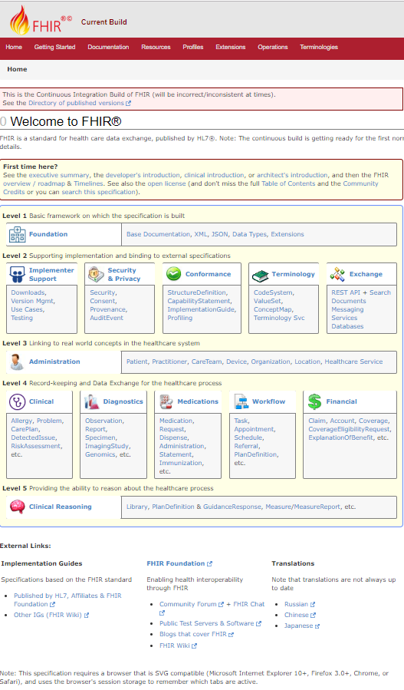
FHIR = magic?
FHIR is a standard for interoperability
Therefore: If two systems both comply with FHIR, they’ll fully interoperate
True or false?
Why not?

Slide 8
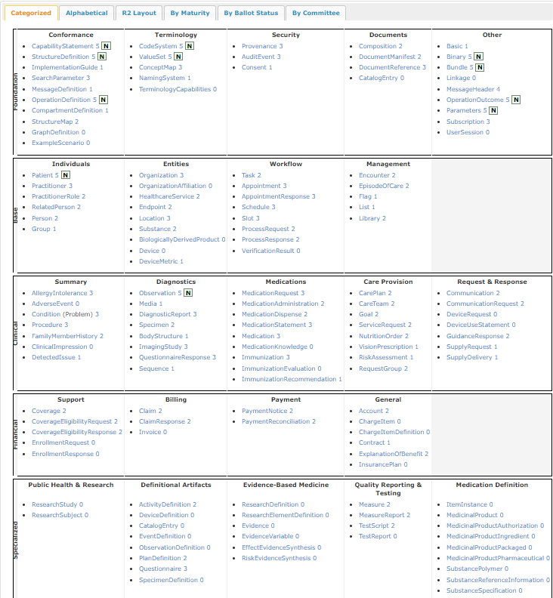
FHIR Resources
140+ resources
How many real systems will support all of these:
CarePlan, SubstancePolymer, PaymentReconciliation, CompartmentDefinition, …

Slide 9
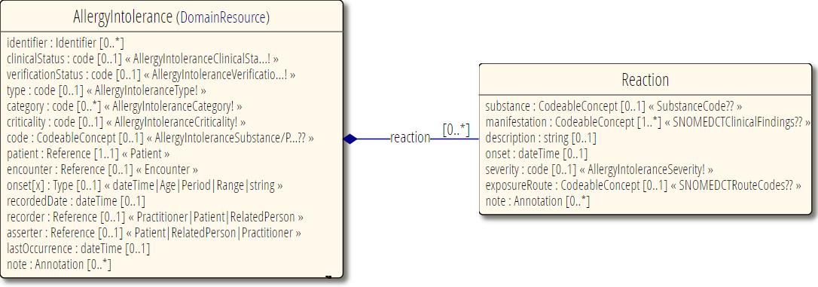
Interoperability - Elements
Most elements are optional
All data type components are optional
Most terminologies unconstrained
Most elements are optional
All data type components are optional
Most terminologies unconstrained

Slide 10
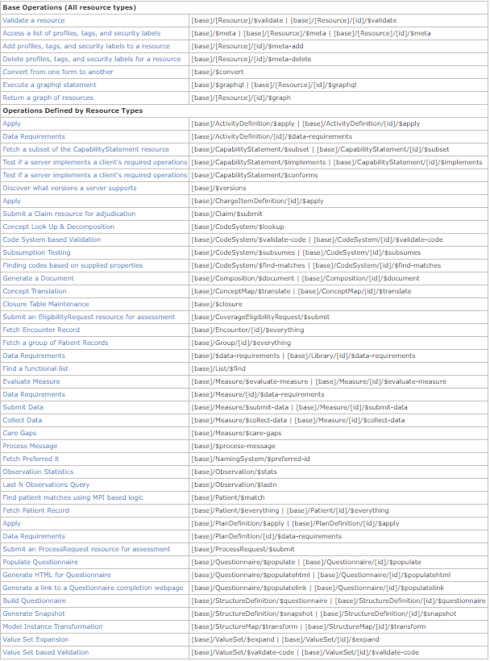
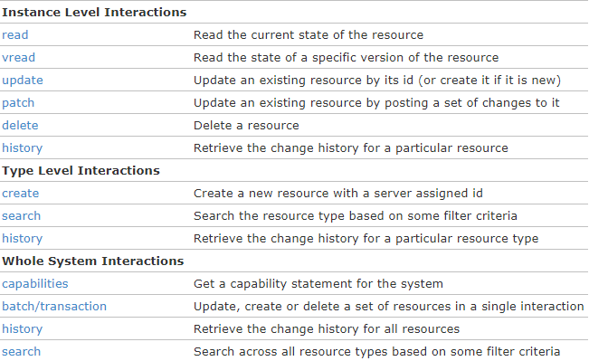
Operations & behavior
Plus custom operations, documents, messages, etc.

Slide 11
The need for profiling
Many different contexts in healthcare, but a single set of Resources
FHIR provides a “platform specification”
Standard building blocks for interoperability solutions
Requires further adaptation to context of use

Slide 12
The need for profiling
Need to be able to describe adaptations based on use and context
What resources and elements are used?
What API features are used?
What terminologies are used?
How to map these to local requirements/implementations?

Slide 13
The need for profiles
Allow for these usage statements to be:
Authored in a structured manner
Published in a repository
Used as the basis for validation, code, report and UI generation

Slide 14
Profile-less FHIR
You don’t need profiles to interoperate with FHIR
Resources are “discrete” enough that mechanisms to populate most elements is clear
Approach
Populate/consume all elements you know, use HL7 or country-standard extensions for extras
Map to/from “recommended” terminologies as much as possible, populate CodeableConcept.text
Expose capabilities in CapabilityStatement resource
Notes:
With profile, they can interoperate ‘ok’.

Slide 15
Profiling Overview And General Principles
Notes:
Time start-10:00 (10 minutes)

Slide 16
FHIR “Profile”
A set of constraints and/or extensions on a FHIR resource
A set of constraints and/or extensions on another FHIR profile
But, “Profile” also refers to:
An implementation guide
A conformance package

Slide 17

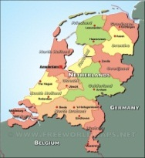

Who publishes?
http://www.hl7.org/fhir/StructureDefinition/iso-21090
http://www.hl7.nl/fhir/StructureDefinition/patient-nl
http://www.health4all.org/fhir/StructureDefinition/
Notes:
“Drive-by” or “bottom-up” operability: “Communicate first, standardize later”
First, business partners. Then, collaborations, communities. Maybe, finally, nation-wide
It’s a natural process that people will want to make it work first, then only coordinate what they really need to, and then realize they can broaden their approach to a community.
“Support”, of course top-down should still be possible! Maybe even a combine in the long-term

Slide 18
Layered profiles
More specific
Core
National
Organizational
Regional
All instances
National instances
Organizational instances
Regional instances
More generic
Conform to
Conform to
Conform to
Conform to
Volume
Volume

Slide 19
Conformance Resources
Terminology
ValueSet
ConceptMap
Content
StructureDefinition
Operations
OperationDefinition
SearchParameter
Misc.
CapabilityStatement
TestScript
Compartment Definition
Implementation Guide
CodingSystem
GraphDefinition
ExampleScenario
StructureMap
MessageDefinition
NamingSystem

Slide 20
Terminology
Define mappings between terms from different systems
ConceptMap
Set of codes for a particular use
ValueSet
CodeSystem
Define a set of concepts and their codes
NamingSystem
Define identifier and coding “systems”

Slide 21
Content
StructureDefinition
Define resources & data types
Define constraints & extensions
StructureMap
Syntax independent transformation of FHIR & non-FHIR instances
GraphDefinition
Defines collection of inter-related resources for query, update, etc.
Notes:
http://Hl7.org/fhir/stu3/conformance-module.html#roadmap
“The exact role of "Data Element Definitions" is still being studied”
R4: DataElement has been removed

Slide 22
Operations
Define additional (custom) operations
SearchParameter
Define additional (custom) searches
OperationDefinition
Compartment Definition
Define access to (related) resources
MessageDefinition
Define message events, content & allowed responses

Slide 23
Miscellaneous
CapabilityStatement
Define set of compliance tests against a FHIR client and server
Define how to use FHIR in a specific use case
TestScript
Define (actual or required) server capabilities
ImplementationGuide
ExampleScenario
Define a workflow showing how resources work together

Slide 24
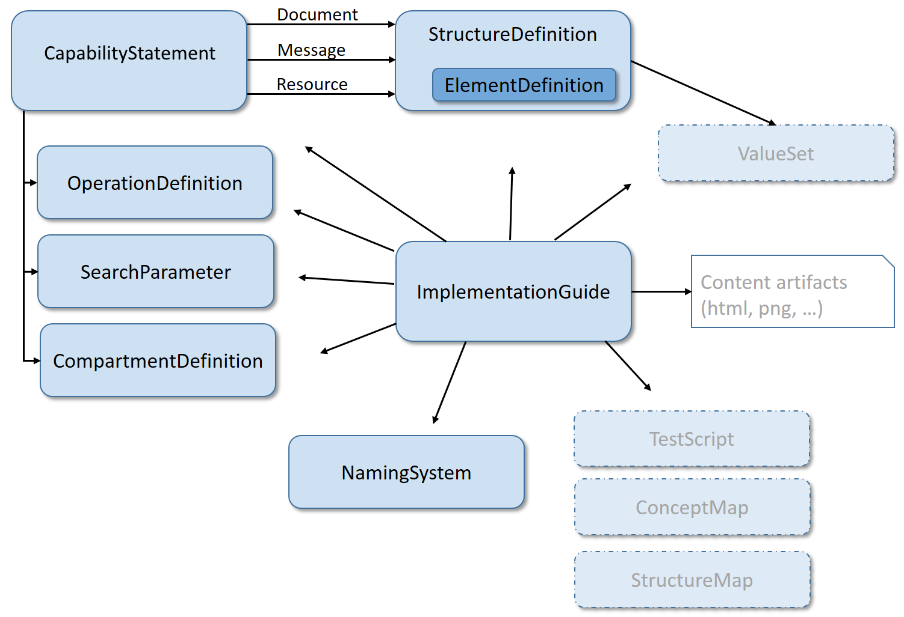
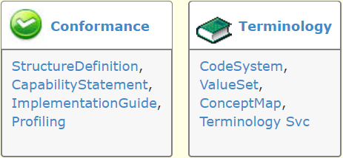
Modules

Slide 25
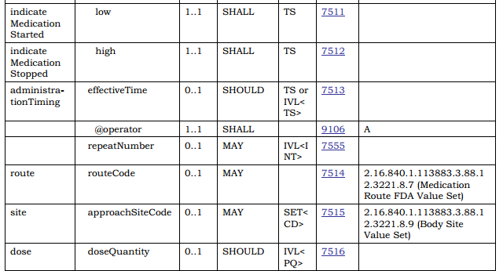
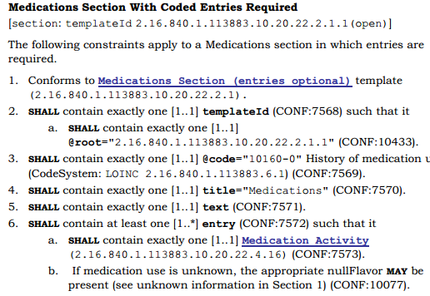
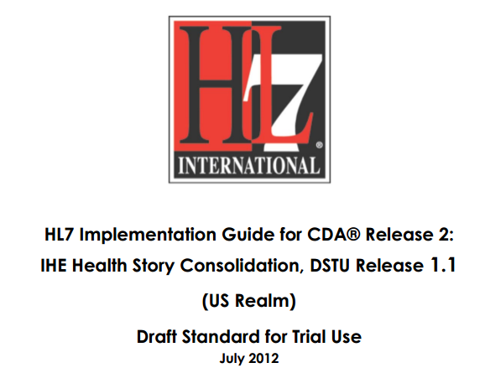
In v3 CDA…”text-based”

Slide 26
Conformance Resources
In FHIR, all conformance resources are in computable form
Share in a registry
Query to find relevant resources
At design time or at runtime
Subscribe to monitor changes
Compare with instances created by others and see where the mismatches are
How well will these systems interoperate?
Code generation

Slide 27
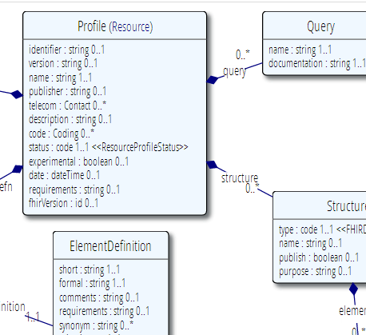







Publish!
Find & maintain
http://simplifier.net
http://registry.fhir.org
Retrieve & use
Notes:
A profile can be published on a FHIR (based) server (it’s a Resource, after all)
On Registry: http://simplifier.net
Or in a version-management system, or by e-mail, or…
As long as people can *find* them, because publishing your profile should help others to find & adhere to it

Slide 28
Tooling
Tools and infrastructure continue to mature
We have tools for profiles, value sets, capability statements
Some beta, many are getting to the “robust” stage
As the FHIR artifacts progress to ‘normative’, tool environments will further mature
Registries are in a similar state
Feedback (and new tools) welcome

Slide 29
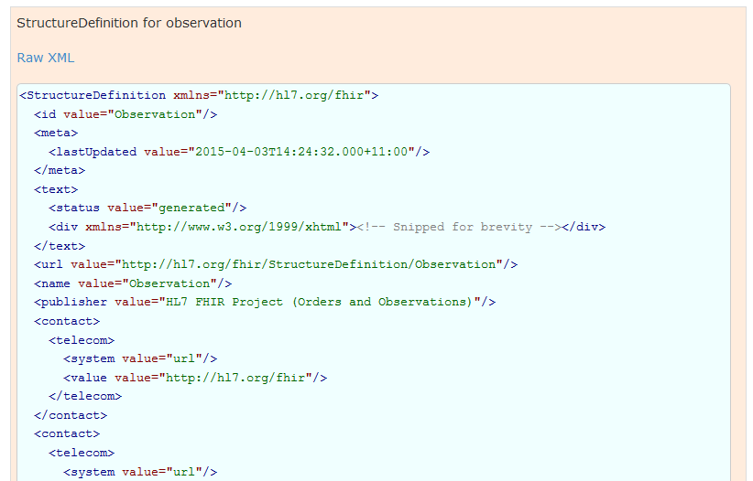
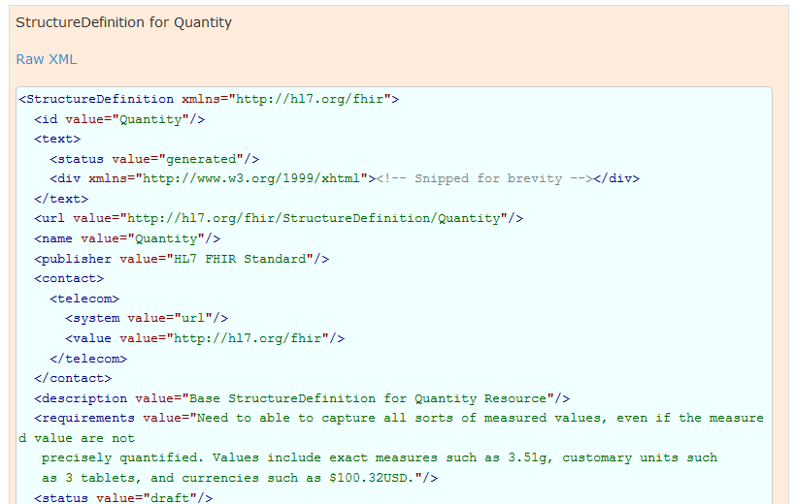
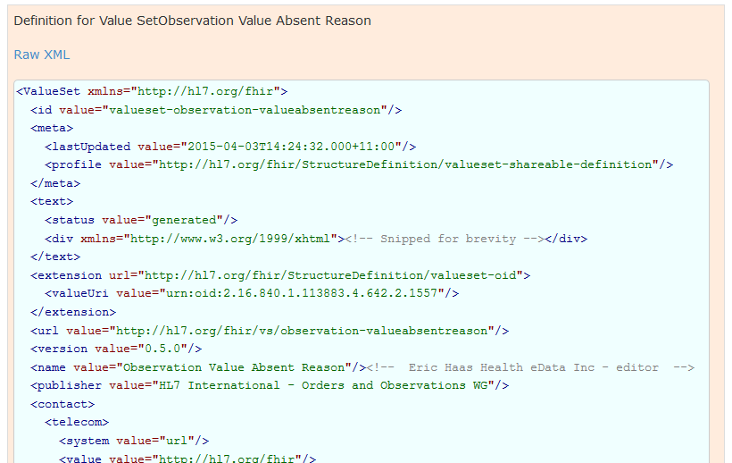
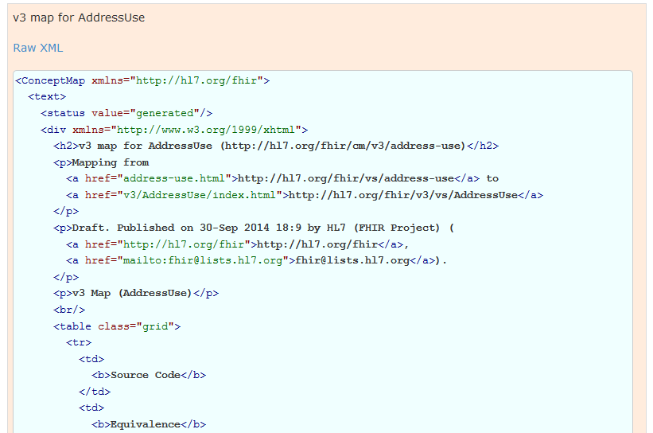
Used in the core spec
For implementer convenience, the specification itself publishes its base definitions using these same resources!
Notes:
See next slide for HTML rendering of these XML structures…

Slide 30
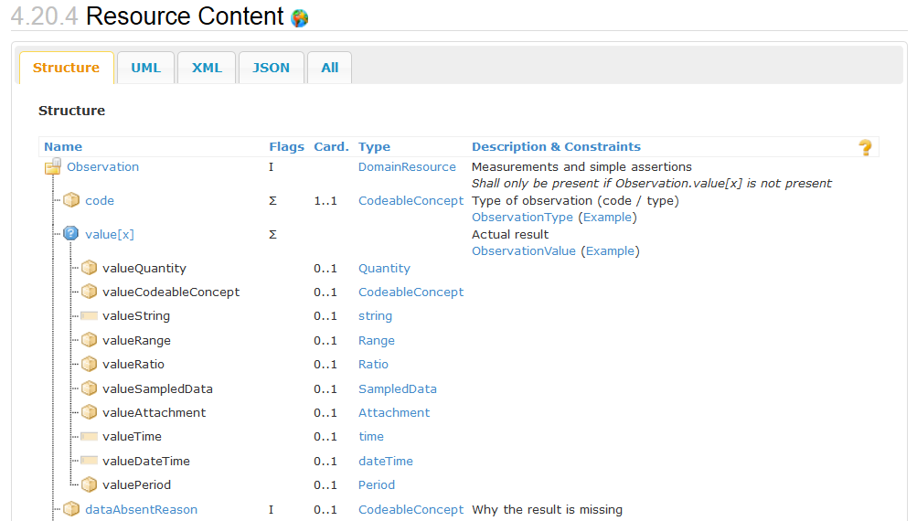
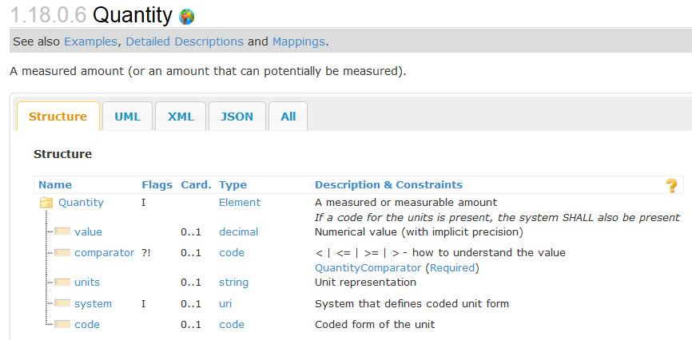
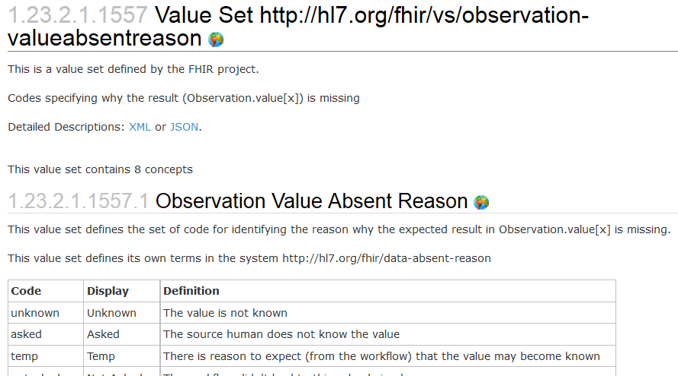
Resources in the core spec
Published specification is generated from those same computable representations

Slide 31
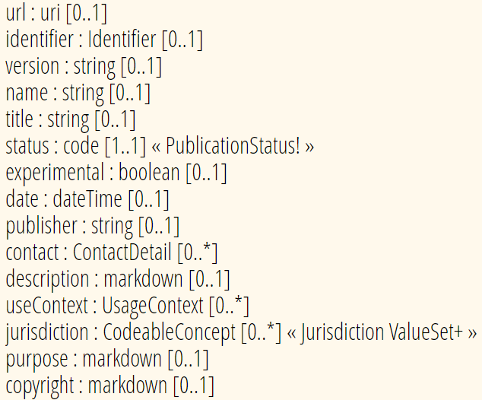
Conformance Metadata
Common across most conformance resources
Supports
Identification
Registration/discovery

Slide 32
Identifying conformance resources
id – Unique to the server the resource is stored on
Conformance resources will be copied many places
Therefore – id is not reliable
url – Canonical URL – consistent across servers
This is how all conformance resources are referenced
version – “business” version – represents a released version
Canonical URL stays the same across versions
identifier – “business” identifier
E.g. OID. Not commonly used

Slide 33
Canonical references
References can be version-specific or version-independent
http://hl7.org/fhir/us/core/StructureDefinition/us-core-procedure
Any version of us-core-procedure
http://hl7.org/fhir/us/core/StructureDefinition/us-core-procedure|3.1.1
US Core as based on FHIR R4

Slide 34
Versioning…
A “version” – author assigned
So what if you change something after publishing?
Just a typo? Change of definition?
Make something optional that wasn’t?
Make something mandatory that was optional?
Add an extension?

Slide 35
“Non-breaking change”?
If old data can still be:
Validated against the new profile
Correctly interpreted against the new profile
This can only be determined by the profile’s authors (and even depends on the way it is used)
Notes:
* E.g. changing the order of questions may in some context considered breaking interpretation, while in others it is not.

Slide 36
Rules for breaking changes?
There are none (so far)
Common practice:
While artifacts are considered “Draft” (e.g. STU status), breaking changes are allowed
Once artifacts are “final” (e.g. Normative status), breaking changes force the creation of new artifacts
You’ll need to define your own policy
Make sure you know the policy for artifacts you reference
Consider version-specific references

Slide 37
Profiling Terminology
Notes:
Time start-10:00 (10 minutes)

Slide 38
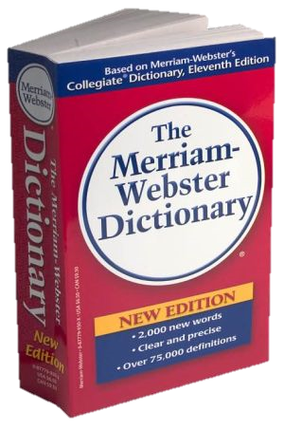
CodeSystem vs. ValueSet
“Dante’s deadly sins”
Pride
Envy
Wrath
Sloth
Avarice
Gluttony
Lust
Takes concepts from…
Definition of terms
An enumeration of terms
“Code System”
“ValueSet”
Example: SNOMED-CT
Example: “Childhood diseases”

Slide 39

“Special” cases
No need to write them all down!
Takes concepts from…
“All words under B”
“All words in the
Merriam-Webster dictionary”
“Words for ‘nerd’”
Bookworm
Geek
Grind
Weenie
Wonk
Dink (slang)
Dork (slang)
Swot (slang)
Takes concepts from…
Takes concepts from…
Can take concepts from multiple coding systems!

Slide 40
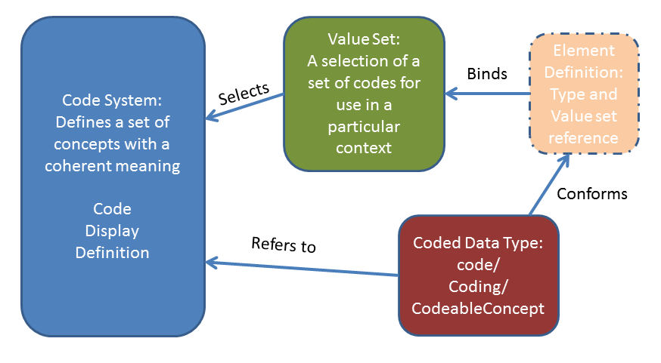
Defining terminology

Slide 41
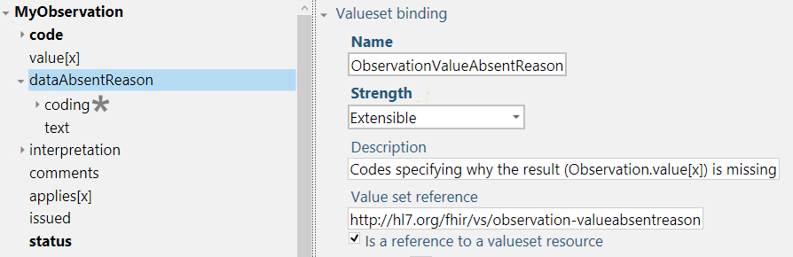
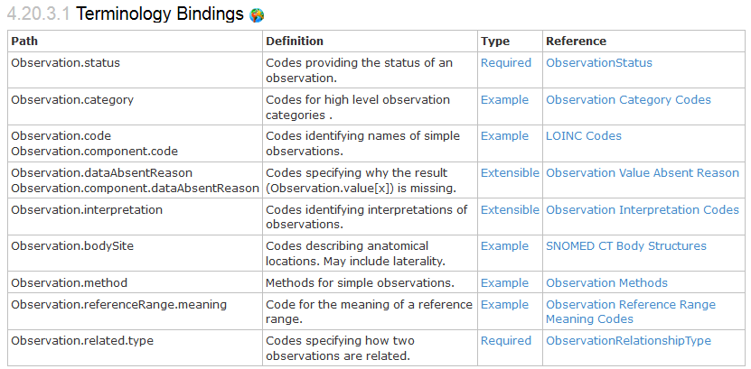
Bindings
When used in a Resource, the modelers include Bindings
Bindings specify which codes can be used
Notes:
Examples is from http://hl7.org/implement/standards/fhir/2015May/observation.html

Slide 42
Binding Strength
required: You must use the specified codes
Or omit the element if no code applies for the concept
extensible: You must use the specified codes if they apply
Free to use other codes or text if the value set doesn’t cover the concept
preferred: You SHOULD use the specified codes
But if you have a good reason, you can use something else instead – it is not required to use the specified codes in order to be conformant
example: These codes just give an idea of what you might use
No expectation (or recommendation) of use

Slide 43
Profiling Terminology
Tighten the binding strength (e.g. Extensible -> Required)
Change the value set
required: Constrain allowed codes
e.g. male/female/other/unknown -> male/female
extensible: May constrain and add concepts not covered by existing codes
preferred, example: Can pick whatever codes you like
But should ideally be able to map to/from preferred codes
You can propose changes to code systems and value sets owned by others
Can define codes in your own code system
Notes:
Two aspects: whether you as a profile author can change the valueset and
Whether the user of your profile can provide codes from other valuesets in an instance
Fhir defines offical extensions for special binding constraints: elementdefinition-maxValueSet and elementdefinition-minValueSet
List: http://hl7-fhir.github.io/elementdefinition-extensions.html
http://hl7-fhir.github.io/extension-elementdefinition-minvalueset.html - The minimum allowable value set, for use when the binding strength is 'required' or 'extensible'
http://hl7-fhir.github.io/extension-elementdefinition-maxvalueset.html - The maximum allowable value set, for use when the binding strength is 'extensible'
Also see issue 9185: http://gforge.hl7.org/gf/project/fhir/tracker/?action=TrackerItemEdit&tracker_item_id=9195&start=0

Slide 44
ValueSet Tooling
Grahame
http://www.healthintersections.com.au/FhirServer
ClinFHIR.com
CodeSystem Builder, ValueSet Explorer
Snapper
http://ontoserver.csiro.au/snapper2-dev/
Apelon
http://www.apelon.com/

Slide 45
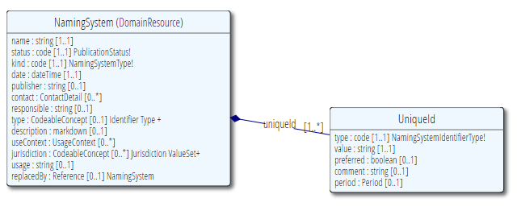
NamingSystem
What’s the URL for Michigan Podiatrist License Number?
New South Wales Driver’s License Number?
When converting between FHIR and CDA, how to I find the OID for this URL (or vice versa)
Notes:
Known Code Systems
http://hl7.org/implement/standards/fhir/terminologies-systems.html
Example: http://hl7.org/implement/standards/fhir/namingsystem-registry.html
id: us-ssn
name: United States Social Security Number

Slide 46
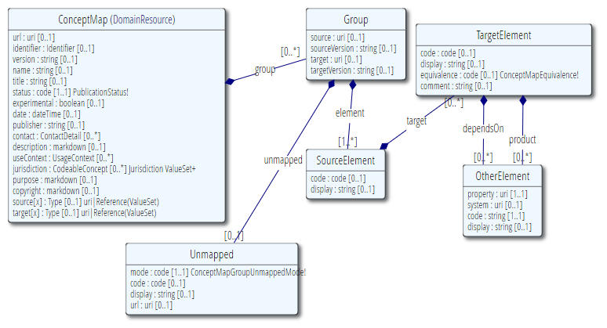
ConceptMap
Define mapping
From one set of concepts to one or more other concept(s)
Notes:
http://hl7.org/implement/standards/fhir/conceptmap-example-specimen-type.html
v2 table 0487 => SNOMED-CT

Slide 47
Profiling Structures

Slide 48
Profile Uses
Why profile structures?
Define content for documents and messages
Define extensions
Set interoperability expectations in a particular context
National standards, types of care, business patterns
Clinical practice guidelines / detailed clinical models
Document system capabilities

Slide 49
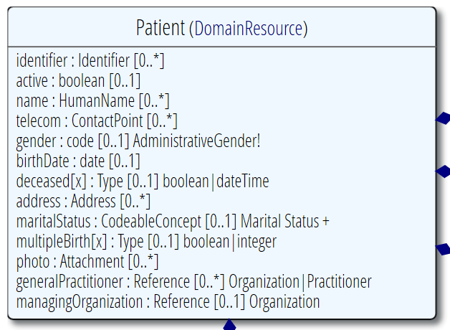
Profiling a resource
Demand that the identifier uses your national patient identifier
Limit names to just 1 (instead of 0..*)
Limit maritalStatus to another set of codes that extends the one from HL7 international
Add an extension to support “RaceCode”
Note: hardly any mandatory elements in the core spec!

Slide 50
Uses for profiles
Server & client may publish and check their conformance to a profile
Validating instances, messages
Implement "FHIR spec-like" website from Profiles as part of an Implementation Guide
Code generation
Dynamic UI Generation

Slide 51
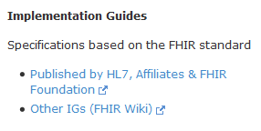
Examples…
Let’s look at US Core Profiles
http://hl7.org/fhir/
Implementation Guides
http://www.fhir.org/guides/registry
Simplifier
https://simplifier.net/ui/ig/SIG
Notes:
Visit http://hl7.org/implement/standards/fhir/daf/daf.html
http://hl7.org/fhir => Implementation Guides => DAF
Example: DAF Patient - http://hl7.org/implement/standards/fhir/daf/daf-patient.html

Slide 52

Referring to a profile
Observation
Cholesterol
6.3 mmol/L
High
(recommended 4.5)
http://acme.org/
http://acme.org/StructureDefinition/LDLCholesterol
Metadata “Lipid Profile” v1.0.0 Draft
urn:acme.org:lipid-profile:v1
Author: e.kramer@furore.com
I’m conforming to (meta.profile=)
http://acme.org/StructureDefinition/LDLCholesterol
Structure ‘cholesterol’
Notes:
* You can formalize these constraining statements into a Profile Structure called ‘cholesterol’
* An Observation instance may use a Tag to assess conformance to that structure
* Validators check the contents of the instance against these constraints
DSTU-2: Resource.Meta.profile (uri)
http://hl7.org/implement/standards/fhir/2015May/resource.html#Meta

Slide 53
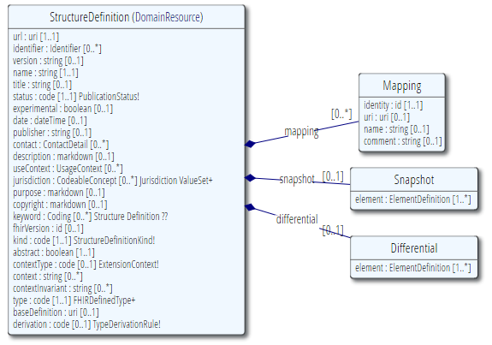
StructureDefinition
Defines datastructures
Core resources
Core datatypes
Constraints on resources & datatypes
i.e. “profiles”
Extensions
Logical Models

Slide 54
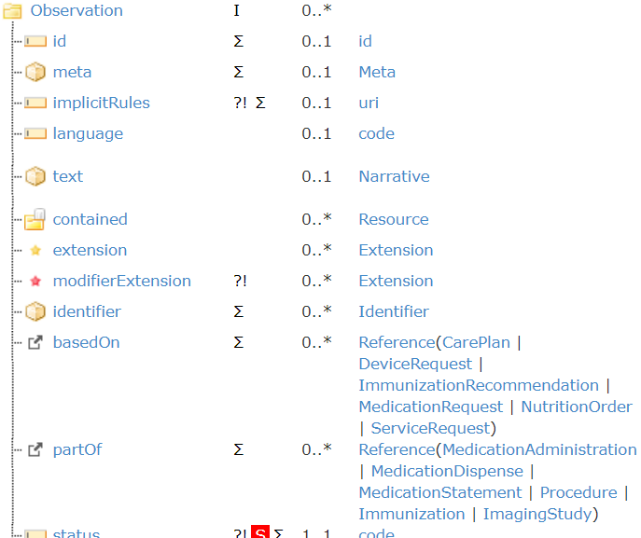
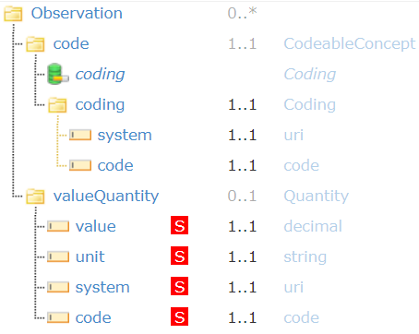
Snapshot vs. Differential

Slide 55
Snapshot vs. Differential
Differential
What’s changed from the base resource?
Added elements
Constrained elements
Only lists what’s different
Snapshot
What happens when you apply those differences to the snapshot of the parent model

Slide 56
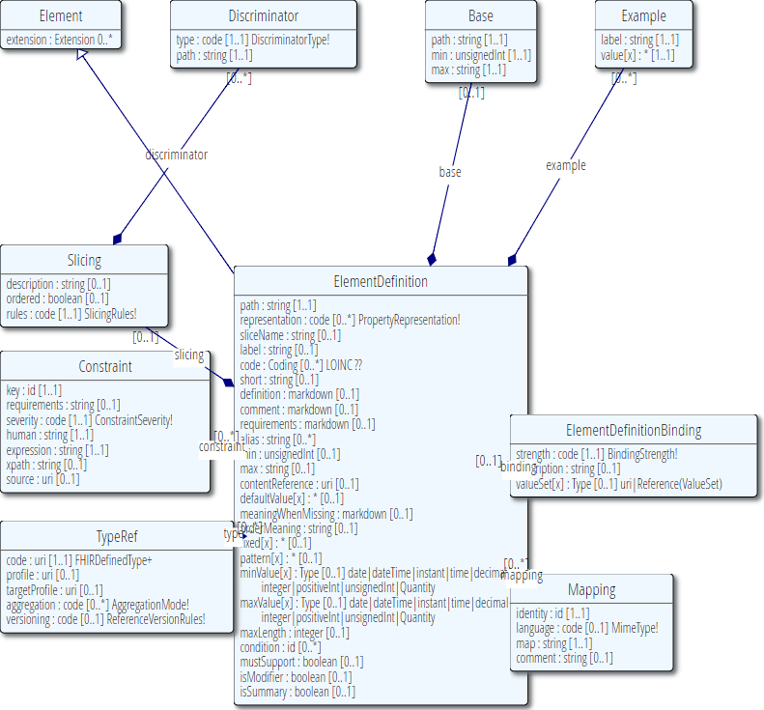
ElementDefinition
Describes every node in a data type, resource or logical model
Name, data type, cardinality, binding, definition, constraints, mappings, …

Slide 57
Must support?
Distinct from cardinality (what must be in instance)
Authors: SHALL be capable of providing a value for the element
Consumers: SHALL be capable of extracting and doing something useful with the element
"Something useful" is context dependent. The profile or implementation guide SHALL describe what it means for applications to “support” the element
[FUTURE] R5 “obligation”
Notes:
Note: the spec *never* sets this to true, since it’s context dependent.
MustSupport is defined on element level
Cf. IsModifier: defined on structure level

Slide 58
Contextualize narrative
Override the base spec’s descriptions by adding context specific narrative:
short : string 1..1
formal : string 1..1
comments : string 0..1
requirements : string 0..1
synonym : string 0..*
example[x] : 0..1 (example value!)
mappings : 0..* (more specific mappings)

Slide 59
Slicing
Schematic view of Composition (aka a Document header)
Composition
type: CodeableConcept
Section
code: CodeableConcept
content: Resource(Any) 0..1
0..*
Slicing = constraining a repeating element
Base Composition has 0..* “Sections”
Section has 0..1 element with content

Slide 60
Slicing into a CCD
Composition
type = “34133-9” “Summarization of
episode note”
Section
code = 42348-3 (“Advance directives”)
Section
code =11450-4 (“Problem list”)
…
Section
code = 18776-5 (“Treatment plan”)
“Slice” the repeating sections into a fixed set of profiled sections.
“code” is fixed and is called the discriminator

Slide 61
Aggregation
Aggregation: for each ResourceReference choose 1..3:
Code | Definition
contained | Reference to a contained resource.
referenced | Reference to a resource that has to be resolved externally
bundled | Reference points to will be found in the same bundle

Slide 62
Profiling “wisely”
Don’t constrain out elements unless they’re a genuine error
Patient can only have one name X
Patient can’t be deceased ✔
If you need to limit repetitions, instead slice and define what you want, possibly with extensions
Patient must have one name with use code of ‘legal’, jurisdiction of U.S. (extension?), and no end date
Patient must have one phone number with “lab call-back” extension

Slide 63
Authoring a FHIR Profile
(deprecated) Excel (build tool)
We’ve moved away from this
FSH/SUSHI: FHIR Shorthand (now the default for IGs)
https://build.fhir.org/ig/HL7/fhir-shorthand
Forge: FHIR-specific profiling tool
https://simplifier.net/forge
Lantana Trifolia Workbench
https://trifolia.lantanagroup.com/
By hand, raw JSON or XML (for the brave/experts)
Generate from code
Notes:
Excel: FHIR Spec\v1.01\fhir-spec\site\uslab\patient-uslab-review.xls
MDHT: https://projects.eclipse.org/proposals/model-driven-health-tools, https://projects.eclipse.org/projects/modeling.mdht
Forge: Create a new Observation profile

Slide 64
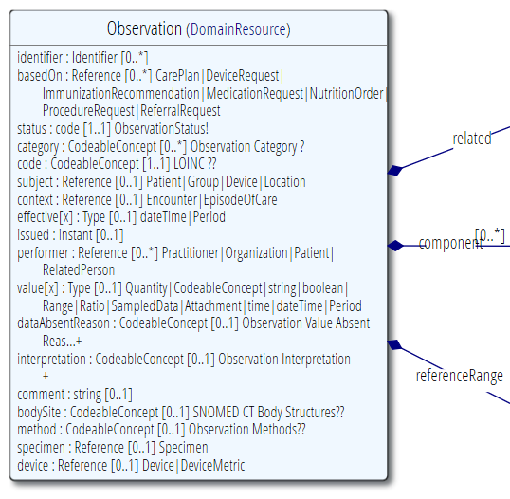

Observation resource

Slide 65
Let’s start constraining!
“if no value…”
1..1

Slide 66
Authoring a Profile
Let’s try this in Forge
Download from https://simplifier.net/downloads/forge
Click “New Profile”
Select base resource, e.g. Observation
Edit metadata on tab page “Properties”
Name
URL
Save!
Notes:
Excel: FHIR Spec\v1.01\fhir-spec\site\uslab\patient-uslab-review.xls
MDHT: https://projects.eclipse.org/proposals/model-driven-health-tools, https://projects.eclipse.org/projects/modeling.mdht
Forge: Create a new Observation profile

Slide 67
Formal constraints
Notes:
Time start-10:00 (10 minutes)

Slide 68
Formal constraints
…beyond cardinalities and bindings, there are a lot of other conditions you might want to formulate:
“If a Cholesterol value result is not available, use the comments field”
“A patient’s birthdate must be on or before today’s date”
These may concern a single element or cover multiple elements.

Slide 69
Formal constraints
Uses free text (human) + FHIRPath (executable)
Constraints should be declared on lowest element in the hierarchy that is common to all nodes referenced by the constraint
Identified by (local) ‘Key’, involved elements refer to that id
Specify severity (“error”, “warning”, “best practice”)

Slide 70
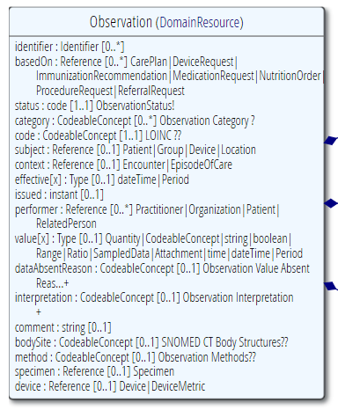
Context of the constraint
“If a Cholesterol value result is not available, use the comments field”
This constraint is on the elements “valueQuantity” and “comments”
We would have to formulate this constraint on the Observation, this is the context of the constraint
We assign the constraint a “key” value that’s unique within the Observations’ constraints
We refer from both “value[x]” and “comments” to this “key”. This means: if my value changes -> revalidate the constraint

Slide 71
Why FHIRPath
Need to enforce constraints in all syntaxes
XML, JSON, RDF, more?
XPath 1.0 is too limited, XPath 2.0 isn’t supported in a number of key languages
Wanted a path language that was terminology aware

Slide 72
FHIRPath vs. XPath
FHIRPath
uniqueId.where(preferred = true).distinct(type)
XPath
not(exists(for $type in distinct-values(f:uniqueId/f:type/@value) return if (count(f:uniqueId[f:type/@value=$type and f:preferred/@value=true()])&gt;1) then $type else ()))

Slide 73
FHIRPath applications
Invariants in ElementDefinition
Slicing discriminator
Search parameter paths
Error message locations in OperationOutcome
URL templates in Smart on FHIR's CDS hooks
PATCH
Testing scenario payload evaluation

Slide 74
FHIRPath syntax
Syntax & formal grammar:
http://hl7.org/fhirpath/
https://github.com/ewoutkramer/fhirpath/blob/master/fluentpath.md
Resembles .NET LINQ / Java query expressions
Example:
Patient.identifier.where(use=‘official’)
Patient.**.extension(‘…url…’)

Slide 75
FHIRPath tools
Nicolai http://niquola.github.io/fhirpath-demo/#/
Brian Postlethwaite https://github.com/brianpos/FhirPathTester
Notepad++ plugin by Grahame http://www.healthintersections.com.au/FhirServer/fhirnpp.htm
Simplifier connector

Slide 76
FHIRPath libraries
Reference implementations
https://confluence.hl7.org/display/FHIR/Open+Source+Implementations
.NET
Java
Delphi
JavaScript
More...

Slide 77
extensions
Notes:
Time start-10:00 (10 minutes)

Slide 78
Extensions
Accommodate those elements not supported by 80% of systems
Note - You’re not extending a resource per se, but you specify where an extension may occur:
A specific element within a resource (even root)
A specific element within a data type
All elements referencing a data type
All elements mapping to a specific mapping target
An extension

Slide 79
Extension Context
An extension has a context type
Resource, Datatype, Extension, Mapping
And a context path
(Resource) Observation
“The observation was calculated”
(Resource) Observation.value
“The observation’s ‘value’ was calculated”
(Datatype) Quantity
“This quantity was calculated” (any Quantity used in any resource!)

Slide 80
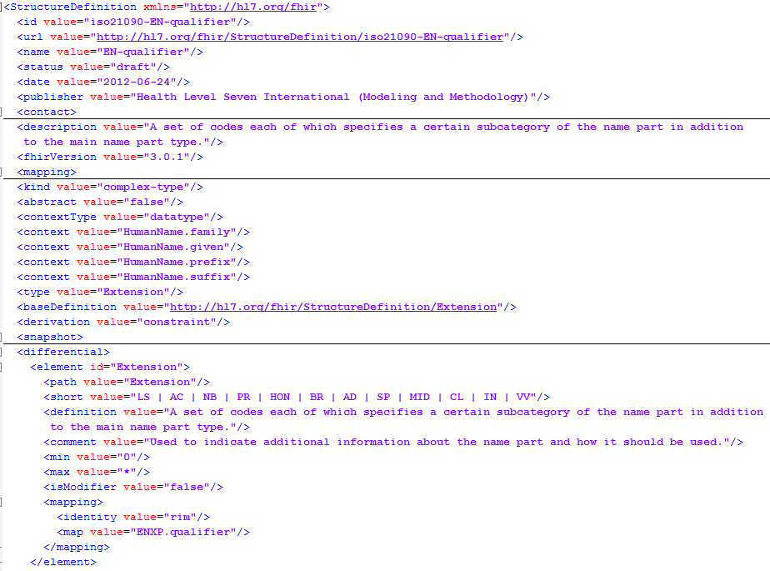
Extension Definition
Support multiple contexts!

Slide 81
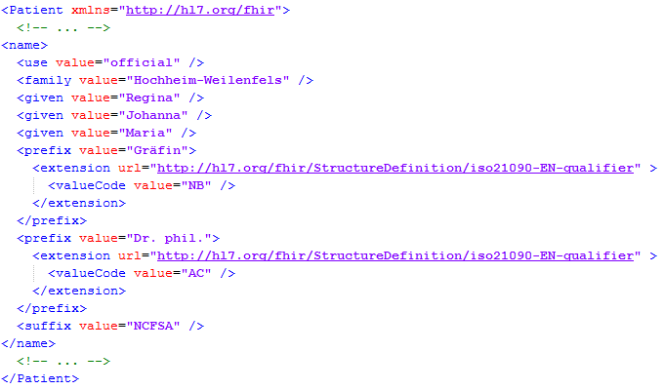
Example: Patient.name extension
Key = location of formal definition
Value = value according to definition
Notes:
http://hl7.org/implement/standards/fhir/2015May/name-part-qualifier.html
NB = Nobility
AC = Academic

Slide 82
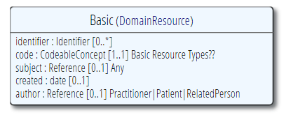
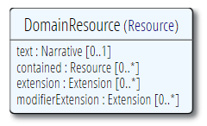
The “Basic” resource
Now, what if you have the need for a completely “new” resource?
…then add extensions for each element

Slide 83
Logical Models
Notes:
Time start-10:00 (10 minutes)

Slide 84
Logical Models
“Tree of data that has no particular use in the FHIR exchange paradigms”
Typically used to represent ad-hoc combinations of FHIR data for packaging convenience
And/or content models as defined by other specifications (e.g. CDA, CIMI, openEHR)

Slide 85
Logical Models
Logical Models may use normal FHIR data types - or even resources
Have the full suite of the FHIR definitional framework to call on (e.g. terminology definitions/service, mapping language, etc)

Slide 86
Logical Models
FHIR Logical Models are found in the Workflow Patterns:
Request
http://hl7.org/fhir/workflow.html#request
Event
http://hl7.org/fhir/workflow.html#event
Definition
http://hl7.org/fhir/workflow.html#definition

Slide 87
Implementation guides
Notes:
Time start-10:00 (10 minutes)

Slide 88
Different Kinds
Strategy
National scope guide
Principles
Overarching principles
Subject
Subject with multiple usecases
Usecase
Single usecase
e.g. medication process
e.g. prescription
e.g. basic components
e.g. infrastructure, security

Slide 89
Typical Content
Title
Table of contents
Document information
Introduction to the guide
Principles & background
Functional requirements and high-level use cases
Design considerations
Package contents (= use case?)
Privacy and security guidance
Testing and certification
Appendix
List of all artifacts used in this guide
Notes:
Best practices, guidelines, default template
Recommended, not mandatory
Proposed template: http://implementationguidetemplate.azurewebsites.net/
Example: https://simplifier.net/ui/ig/SIG

Slide 90
Examples
US Core
http://hl7.org/fhir/us/core/index.html
C-CDA on FHIR
http://hl7.org/fhir/us/ccda/index.html
Da Vinci - Coverage Requirements Discovery
http://hl7.org/fhir/us/davinci-crd/index.html
International Patient Summary
http://hl7.org/fhir/uv/ips/index.html

Slide 91

Implementation Guide Resource
Define content structure
References to external artifacts
Page content files
Images, CSS, JavaScript
Supported page formats:
Markdown
HTML

Slide 92
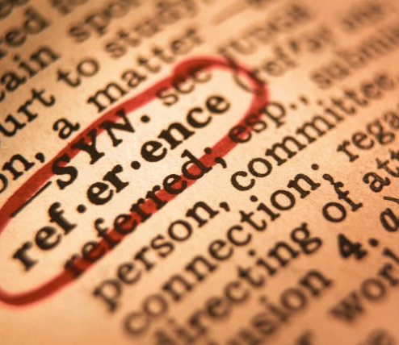
Implementation Guide Resource
Define conformance package(s)
Set of conceptually related artifacts
Based on FHIR NPM package
Specify references to external artifacts
StructureDefinition
OperationDefinition
SearchParameter
ValueSet
Example resources
etc.

Slide 93
Implementation Guides & Package
Implementation Guide
Provides human-readable information (narrative)
Contains formatted text, pictures, attachments, …
Explains to developers how to implement a specific use case
Publish to local/online website or to PDF
Package
Provides machine-readable information (computable)
Contains conformance resources
Allows machines to validate, generate code, generate UI, …
Publish to FHIR Package server

Slide 94
Authoring Implementation Guides
IG Publisher
Official HL7 open source command-line tool
Can render IG resource as a website
Using HL7 IG templates
Uses FSH/SUSHI
Download at:
https://github.com/HL7/fhir-ig-publisher/releases/latest/download/publisher.jar

Slide 95
Authoring Implementation Guides
Simplifier
Browse & find published IGs
Supports online IG authoring & publication
Embed rendered artifacts
Templates allow you to adjust look & feel

Slide 96

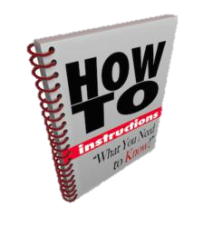
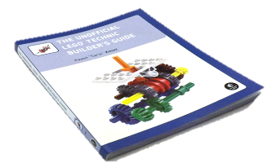


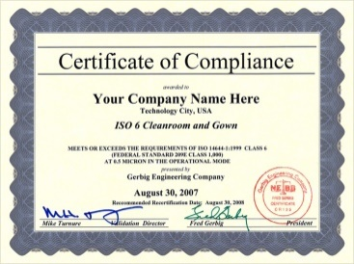

Publish!
Guide
Author & Store
Publish
http://simplifier.net
http://registry.fhir.org
Implement
Test & Verify
Notes:
Authoring workflow ⬄ Publishing workflow

Slide 97
Other Conformance Resources
Notes:
Time start-10:00 (10 minutes)

Slide 98
OperationDefinition
Describes additional operations over and above the RESTful interactions defined in the specification
RPC calls with FHIR
What is the name?
Input/output parameters
What does it do?
Works on which resources?
Notes:
Example: http://hl7.org/implement/standards/fhir/operation-valueset-validate-code.html
ValueSet validation

Slide 99
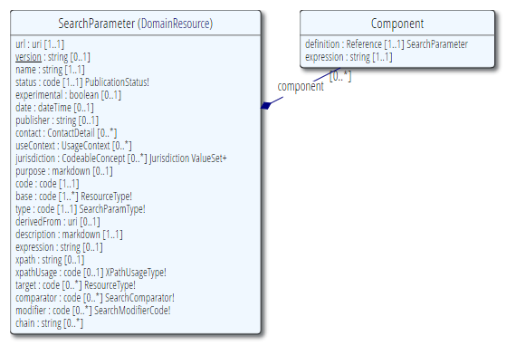
SearchParameter
Extend/restrict searches
Describes additional searches to filter resources
What is the name?
Elements filtered
Resource the search works on
Notes:
Note: better resource name would be “SearchParameterDefinition”
Example: HelseNord REKVIRENT extension

Slide 100
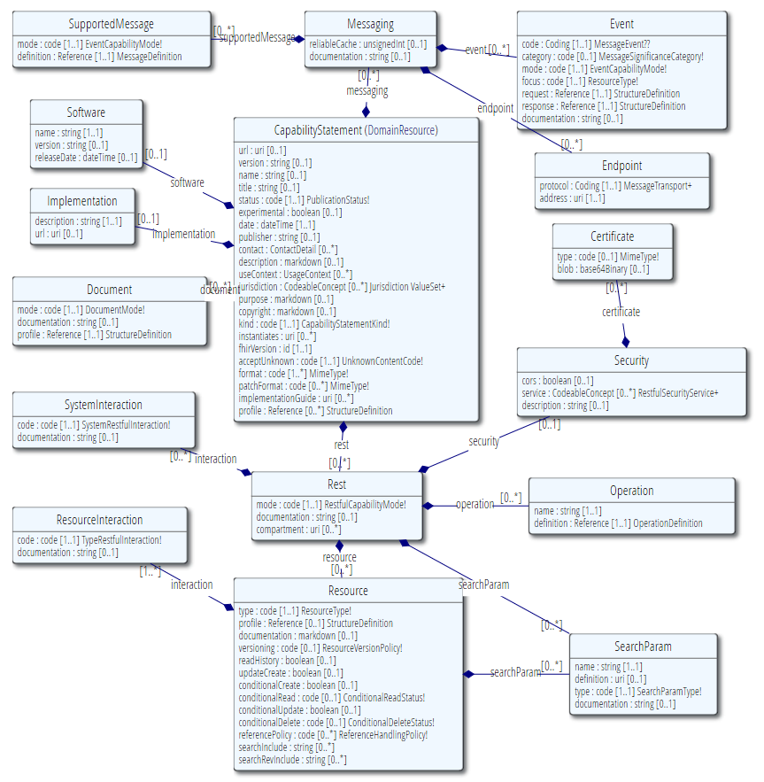
CapabilityStatement
A set of capabilities of a FHIR Server
Binds all conformance resources together
Large beast…
Notes:
Note: better resource name would be “SearchParameterDefinition”

Slide 101
CapabilityStatement
Describes how a client or server uses or should use the FHIR API
Which wire formats supported?
Which resources?
Which operations supported?
Which profiles supported?
Is this a test server?
What’s the name of the software?
Notes:
Note 1: API performs an (optional) version check on the first call
Note 2: Conformance resource for a fully fledged FHIR server can be quite large, e.g. 1.5MB

Slide 102
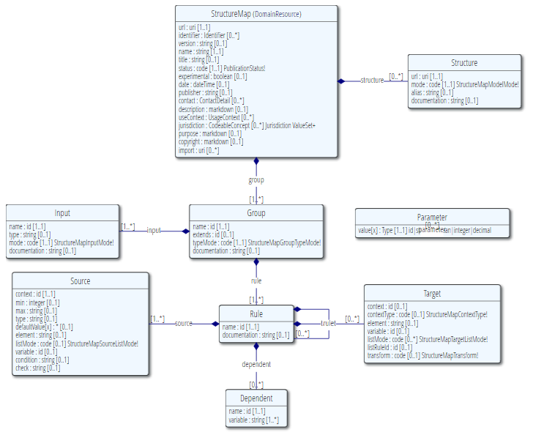
StructureMap

Slide 103
FHIR Mapping Language
Addresses 2 very different kinds of transformations:
Structural changes between the source and target structures
Differences in formats in string (and related) primitives contained within the structures

Slide 104
Registries
Notes:
Time start-10:00 (10 minutes)

Slide 105
Official HL7 FHIR registries
HL7 FHIR Package registry
https://registry.fhir.org
Find official profiles published by HL7 intl. & WGs
HL7 FHIR Implementation Guide registry
http://www.fhir.org/guides/registry
Browse official HL7 implementation guides

Slide 106

registry.fhir.org

Slide 107
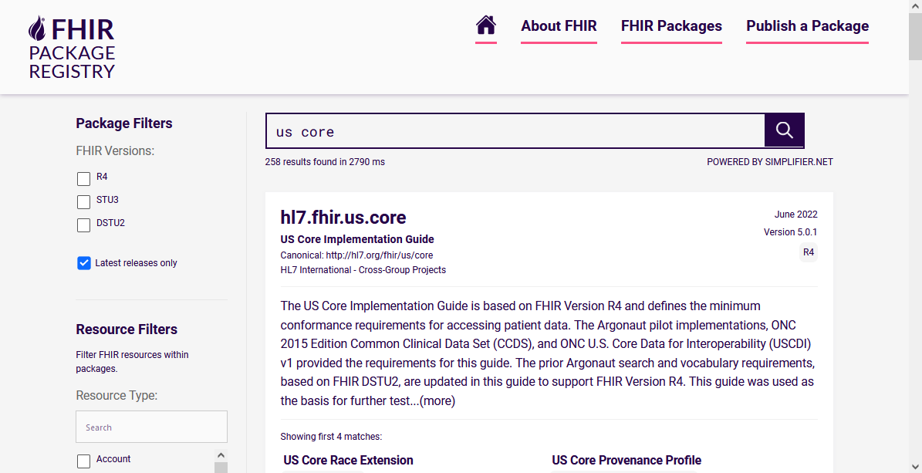
registry.fhir.org

Slide 108

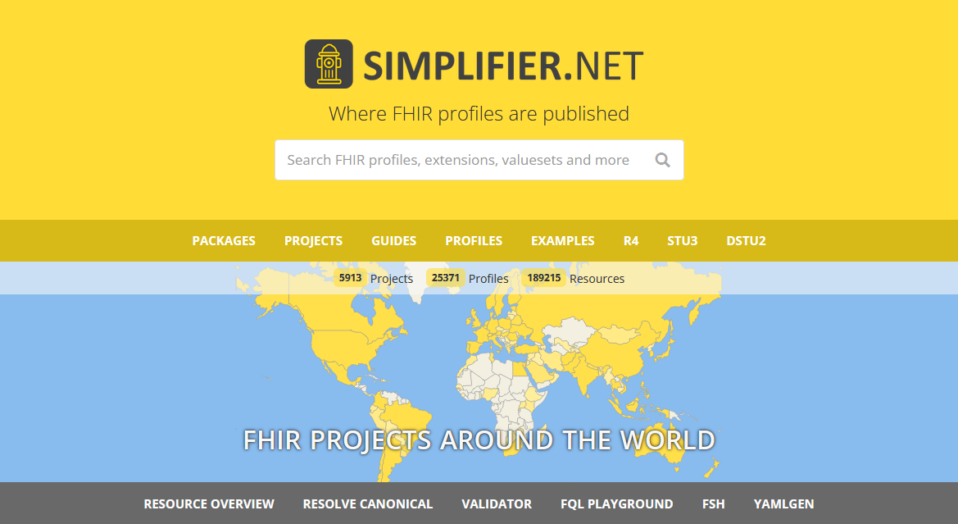
Public FHIR Registry
FHIR NPM Package Server
Search, browse & find FHIR conformance resources:
Profiles, IGs, Valuesets, Examples
Contains:
Official HL7 profiles
HL7 affiliate profiles
Public user profiles
Private company profiles
https://simplifier.net
Notes:
Demo!

Slide 109
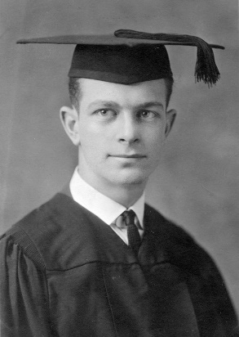
Profiling Academy
Learn to create (better) profiles
https://fire.ly/training/hl7-fhir-profiling-course
Short, digestible training modules
Examples & Exercises

Slide 110

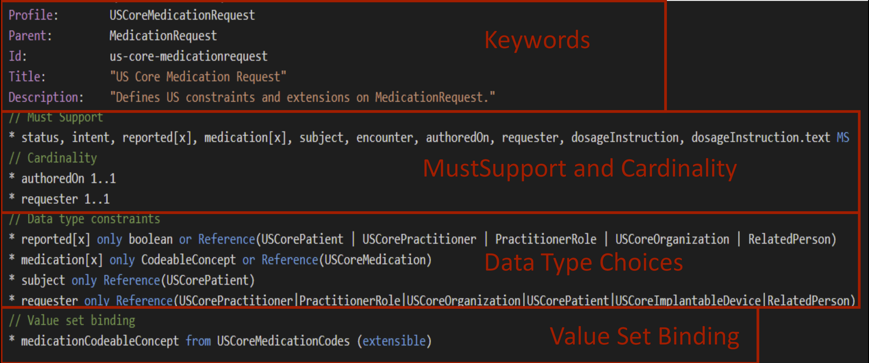
FHIR Shorthand (FSH)

Slide 111
FHIR Shorthand
Has its own Implementation Guide
http://hl7.org/fhir/uv/shorthand
Significant time-savings for authors
Easy source-control management
Less hand-holding than GUI-based solutions
Quick demo – using local IG Publisher tooling…

Slide 112

Wrap Up - Discussion (Q&A)
https://chat.fhir.org/#streams/179252/IG%20creation
richard.ettema@aegis.net

